Slide 1
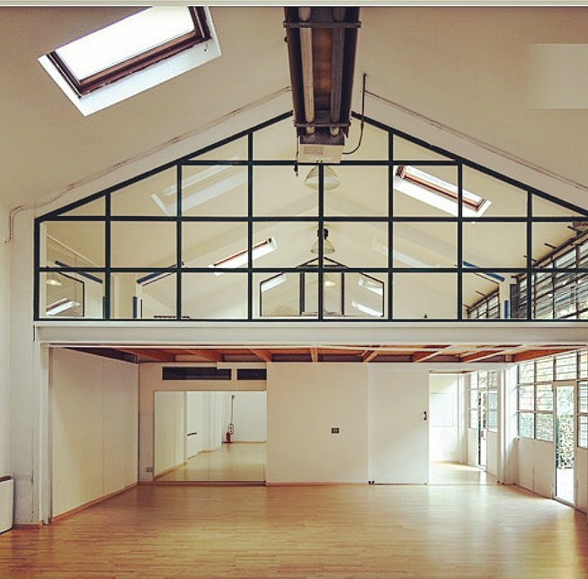
PERGOLA 15
A Space with a Soul

Slide 2
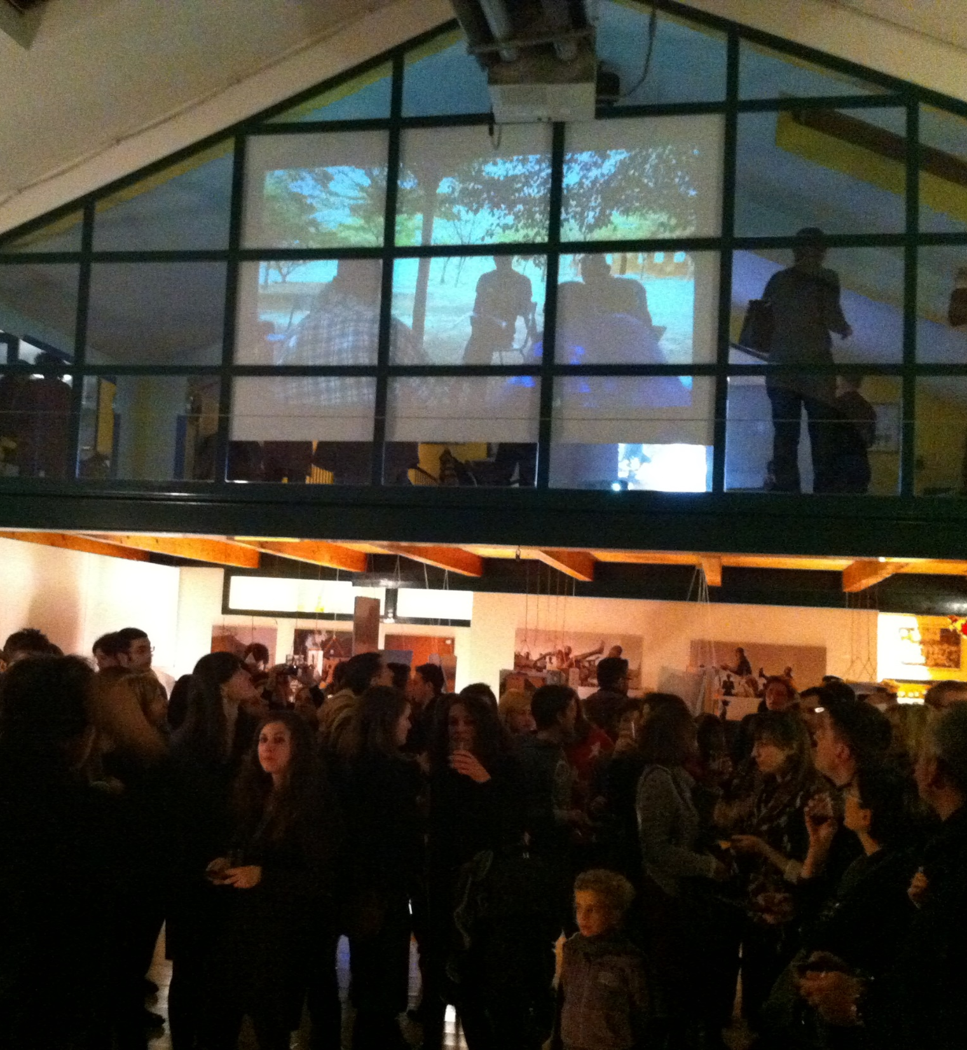
Pergola 15 Our Philosophy
Pergola 15 is a landmark location in the heart of Milan’s Isola district.
For over two decades we have arranged and hosted a range of sporting and music events, art exhibits, conferences and community initiatives.
We aim to become the preferred partner for any individual or organisation seeking a different solution for their corporate events, sales activities or temporary needs for quality space.
We provide a unique facility and work with you to create the right space and help you make your every project a success.
Pergola 15 is not just walls and a ceiling, but a collector of experiences accumulated with the contribution of thousands of people who have worked with us over the years.
Come and see for yourself how we can help you shape your ideas into a memorable experience for your guests and clients..

Slide 3
Pergola 15 Our Location
The space is smartly crafted on 2 levels with a main open area on the ground floor and separate, secluded upstairs loft.
The high ceilings give a sense of open space and the glass windows and Velux solutions on the roof ensure the place is flooded with natural light.
The architecture and general feel is of an industrial warehouse, providing the ideal settings to develop specific ideas and themes for your events.
The space is also conceived to allow for effective use of visual and audio equipment, projections and to quickly organise temporary set up for specific events (showrooms, photo galleries etc.)
XXXXXX Titta (magari due o tre pagine con le foto nuove)

Slide 4
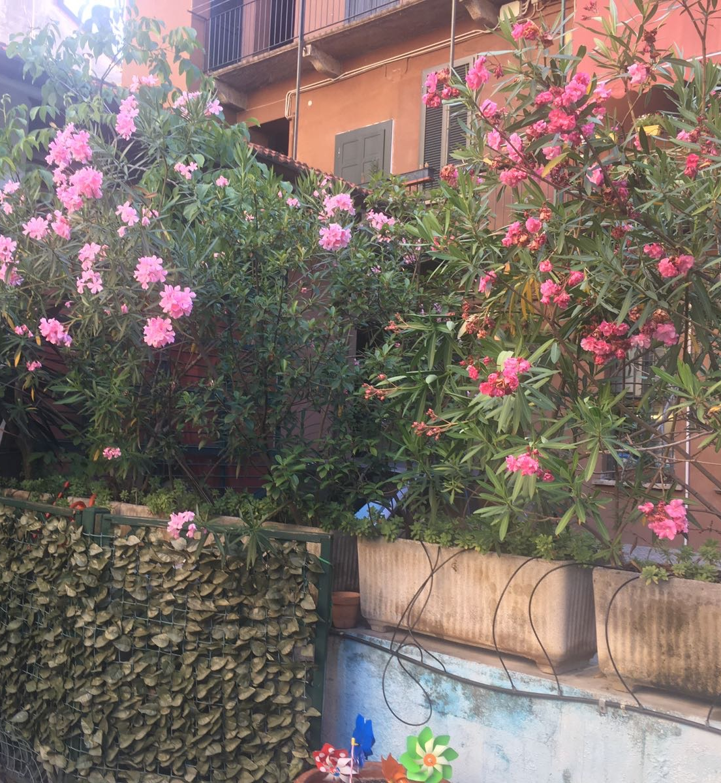
Pergola 15 Our Services
Cleaning, internet, parking, booking, temporary furniture rental,
XXXXXX Titta to expand

Slide 5
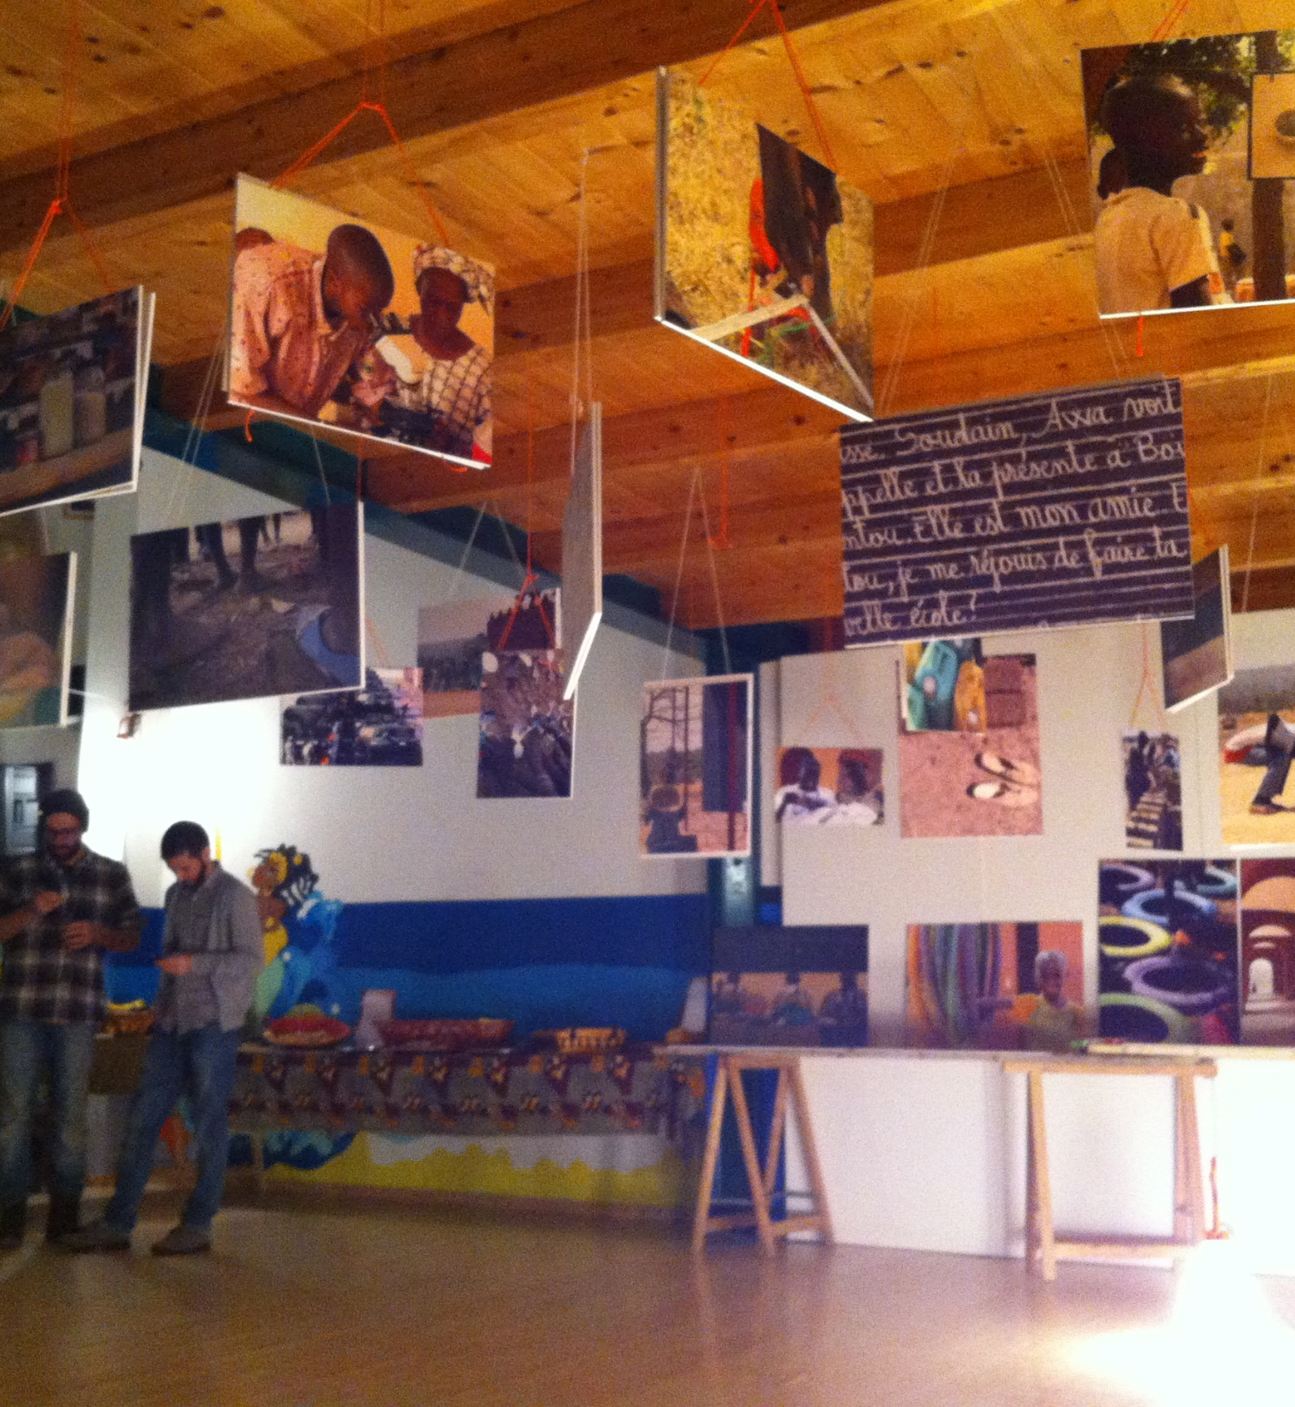
Pergola 15 Contact Details
www.pergola15.it (To be confirmed)
umberta.pellizzetti@gmail.com
Tel –
Facebook

Slide 6
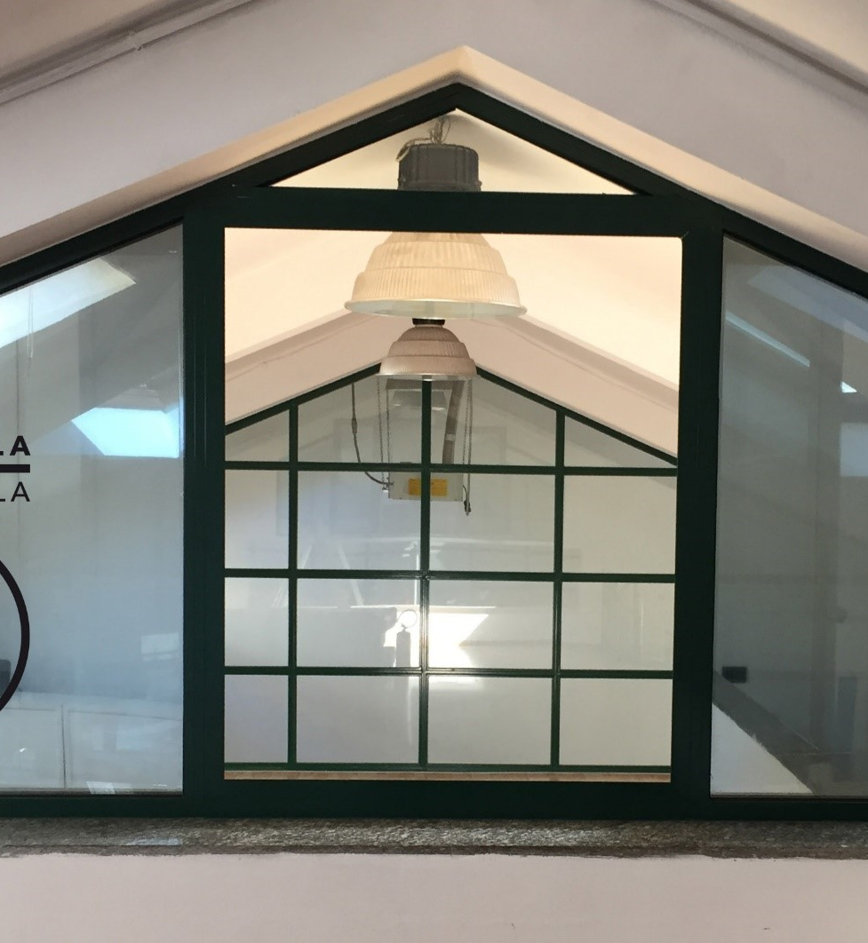
Pergola 15 At a glance
Capacity (120)
Square Meters (150) Square ft (xx)
Disable access
2 toilets and shower
Secure space (lockers) etc. etc
Bisogna scaricare da un sito un prospettino di uno spazio simile per vedere le info fondamentali da dare

Slide 7
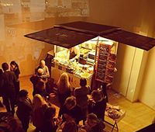
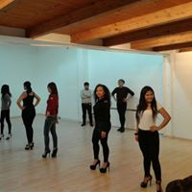
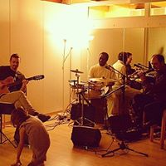
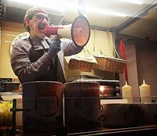
Pergola 15 Our Events
Metterci I loghi di tutte le organizzazione che hanno usato lo spazio (da Mitoka a Comune Milano, altre associazioni, la fonderia etc?)
Lista complete di tutti I “tipi” di eventi fatti o proposti
Magari I testimonials della gente (anche da AirbNB), tipo: “Fantastic location with a great vibe (Lu, China, January 2018)”

